Slide 1


FRAUD DETECTION
Github: https://github.com/JONY-git28/Mentorness-Machine-Learning-Internship/blob/main/Fastag_Fraud_Detection.ipynb
Colab link: https://colab.research.google.com/drive/1kLPUri038VHnGcAqC0LrQbPmZDm8VGX-#scrollTo=lKrY3NEBNtf5
Name : JONY A

Slide 2

Dataset Description:
1. Transaction_ID: Unique identifier for each transaction.
2. Timestamp: Date and time of the transaction.
3. Vehicle_Type: Type of vehicle involved in the transaction.
4. FastagID: Unique identifier for Fastag.
5. TollBoothID: Identifier for the toll booth.
6. Lane_Type: Type of lane used for the transaction.
7. Vehicle_Dimensions: Dimensions of the vehicle.
8. Transaction_Amount: Amount associated with the transaction.
9. Amount_paid: Amount paid for the transaction.
10. Geographical_Location: Location details of the transaction.
11. Vehicle_Speed: Speed of the vehicle during the transaction.
12. Vehicle_Plate_Number: License plate number of the vehicle.
13. Fraud_indicator: Binary indicator of fraudulent activity (target variable).

Slide 3


Project Objectives:
1. Data Exploration:
Explore the dataset to understand the distribution of features and the prevalence of fraud indicators.
2. Feature Engineering:
Identify and engineer relevant features that contribute to fraud detection accuracy.
3. Model Development:
Build a machine learning classification model to predict and detect Fastag transaction fraud.
Evaluate and fine-tune model performance using appropriate metrics.
4. Real-time Fraud Detection:
Explore the feasibility of implementing the model for real-time Fastag fraud detection.
5. Explanatory Analysis:
Provide insights into the factors contributing to fraudulent transactions.

Slide 4
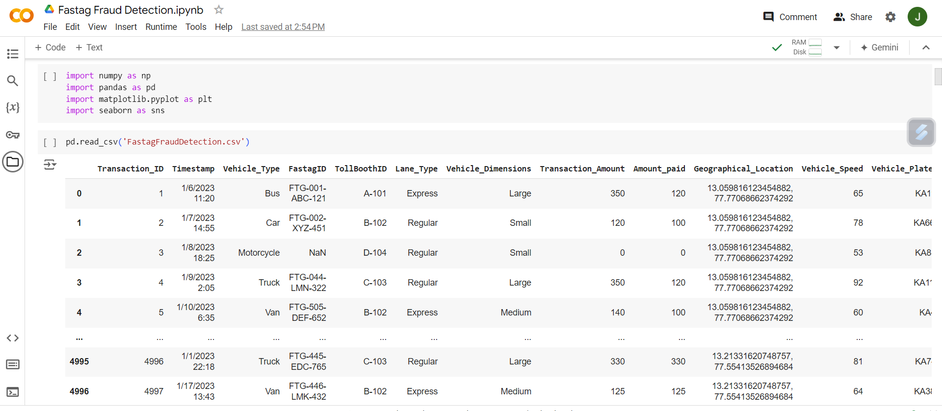
Reading the dataset FastagFraudDetection.csv
Storing dataset in a variable named ‘data’

Slide 5
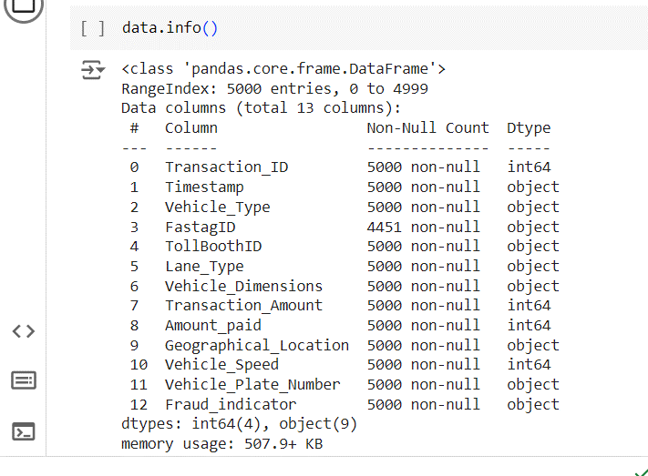
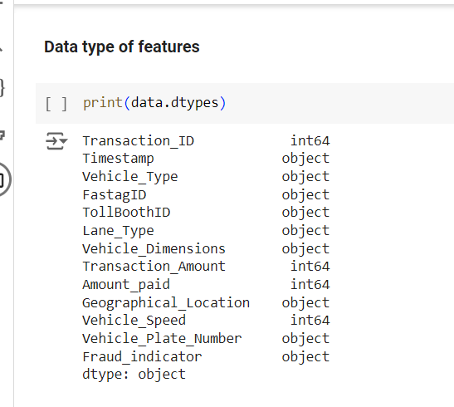
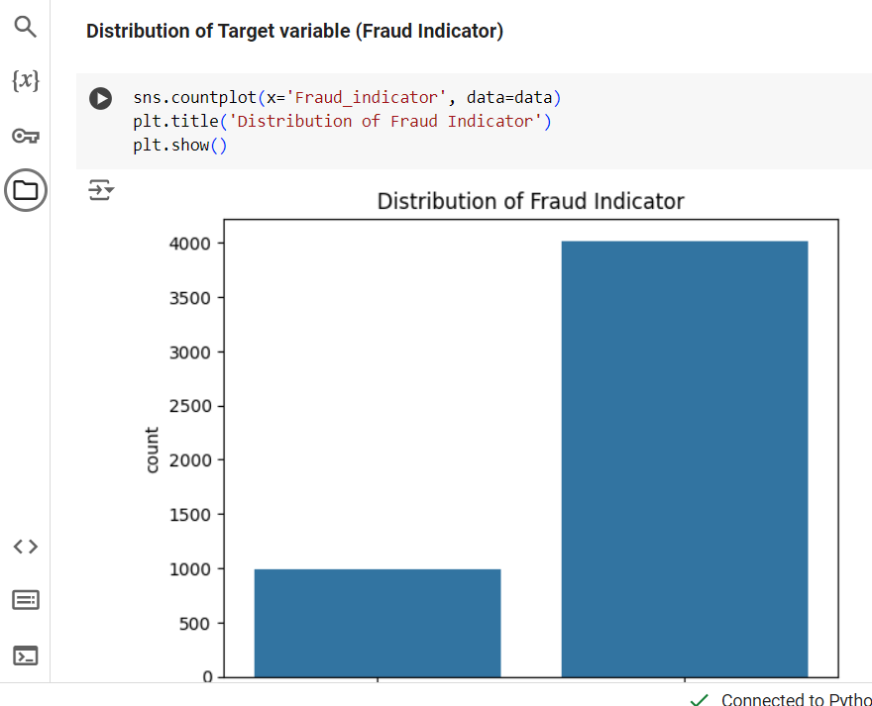
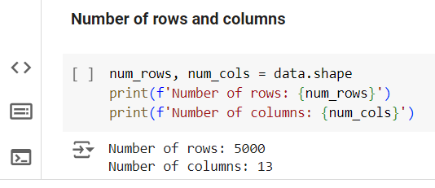
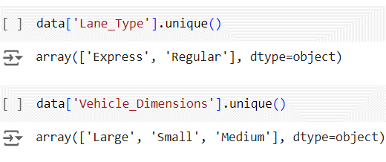
Getting info of dataset : Details about features in the dataset
Rows and Columns: Rows: 5000, Column : 13
Data types : Getting data types of the available features
Distribution of target variable : Used count plot to display distribution of target variable (Fraud or Not Fraud)
Unique values : Getting unique values from Lane_Type and Vehicle_Dimensions

Slide 6
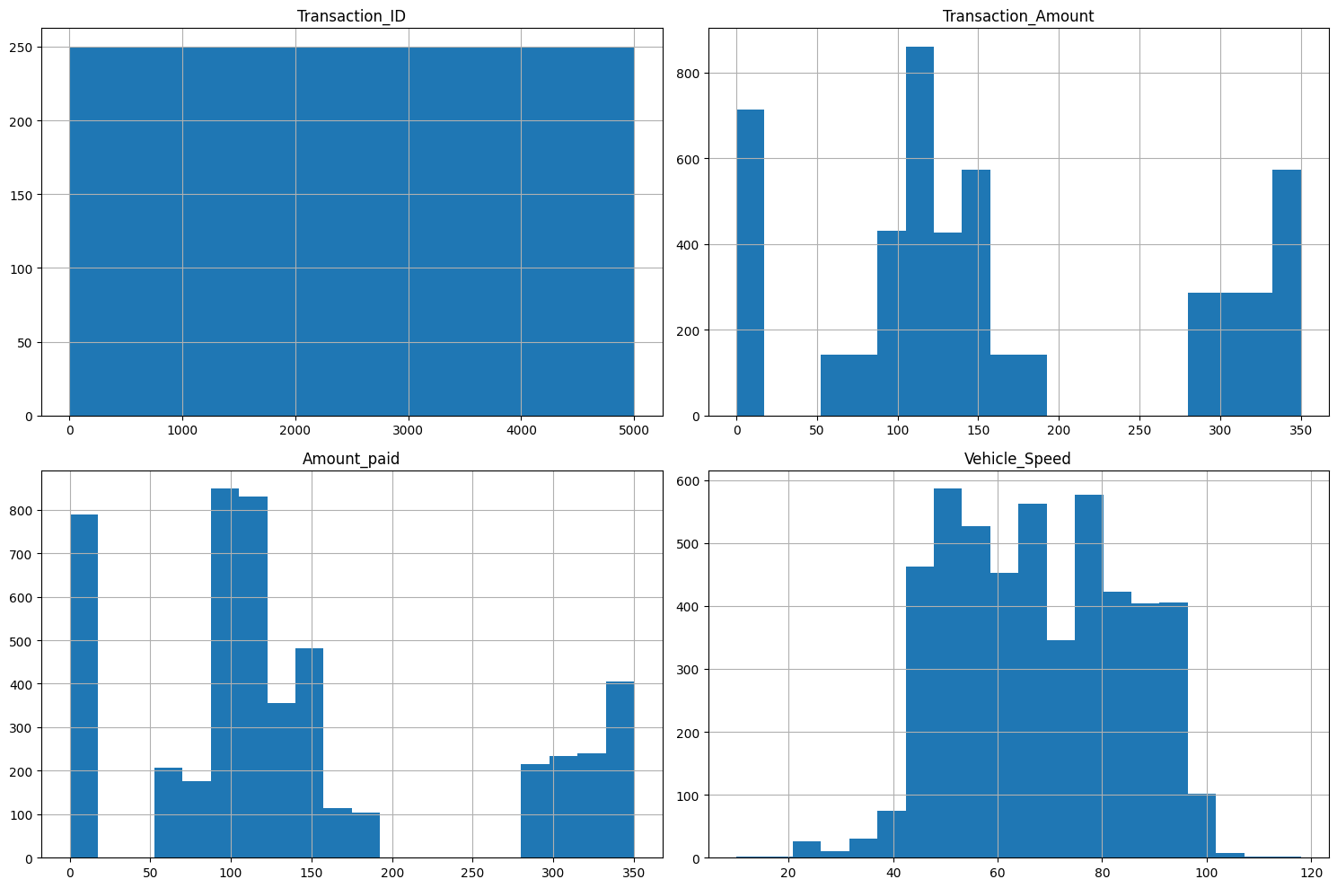
Visualizing the distribution of other features

Slide 7
Feature Engineering:
Dropped unnecessary columns.
Features kept for Fraud detection and their importance:
1.Lane_Type: Detects unusual usage patterns and unauthorized access in express vs. regular lanes.
2.Vehicle_Dimensions: Ensures fees match vehicle size and identifies sudden changes in usage.
3.Transaction_Amount: Matches fees to lane type and vehicle size; spots deviations and protects revenue.
4.Amount_Paid: Verifies payments match transaction amounts; investigates discrepancies and patterns of underpayment

Slide 8
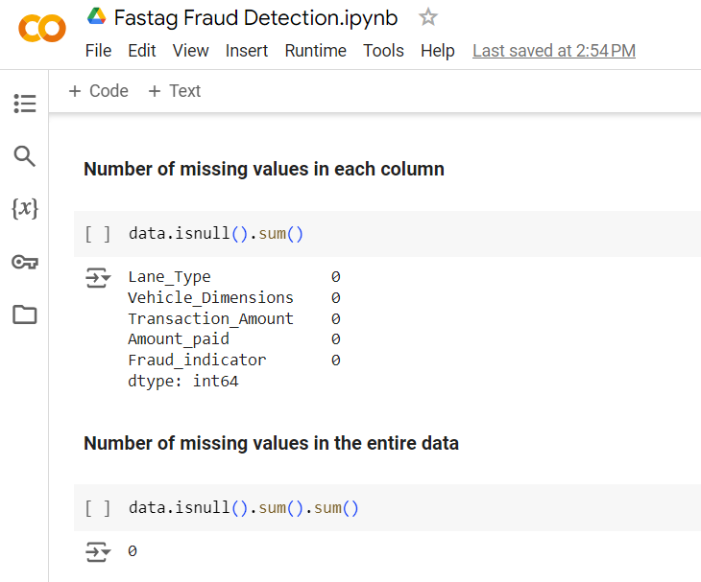
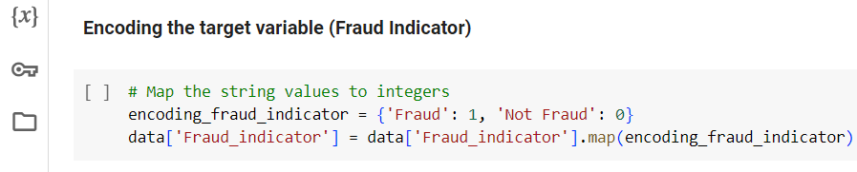
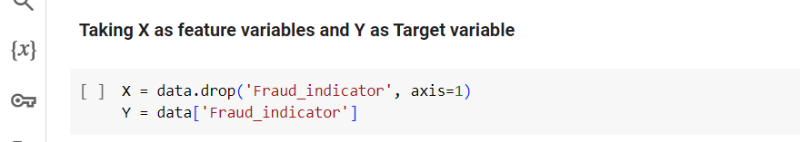
Checking number of missing values in each column and total number of missing values in the dataset
There is no missing value in the data
Storing the features to detect fraud in variable X and the Target variable in Y

Slide 9
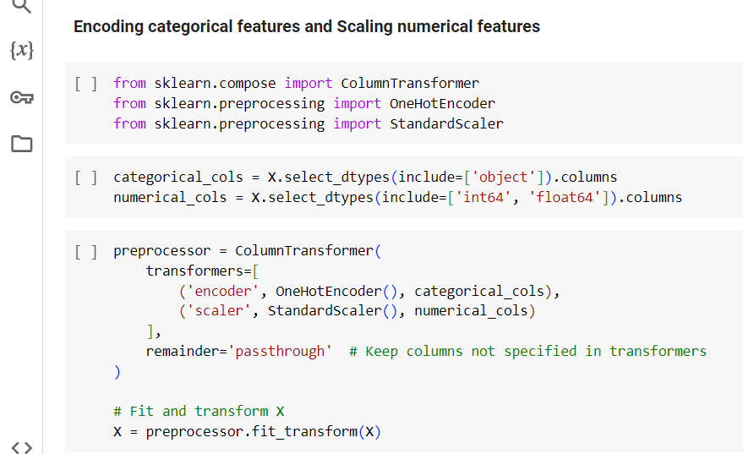
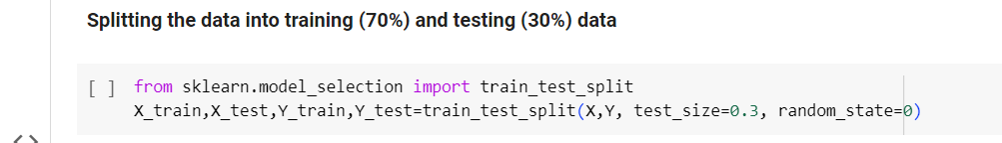
Encoding Categorical Features: OneHotEncoder() for categorical variables.
Scaling Numerical Features: StandardScaler() applied to numerical features in the dataset.
Data Splitting: Train-Test Split: 70% training, 30% testing.

Slide 10
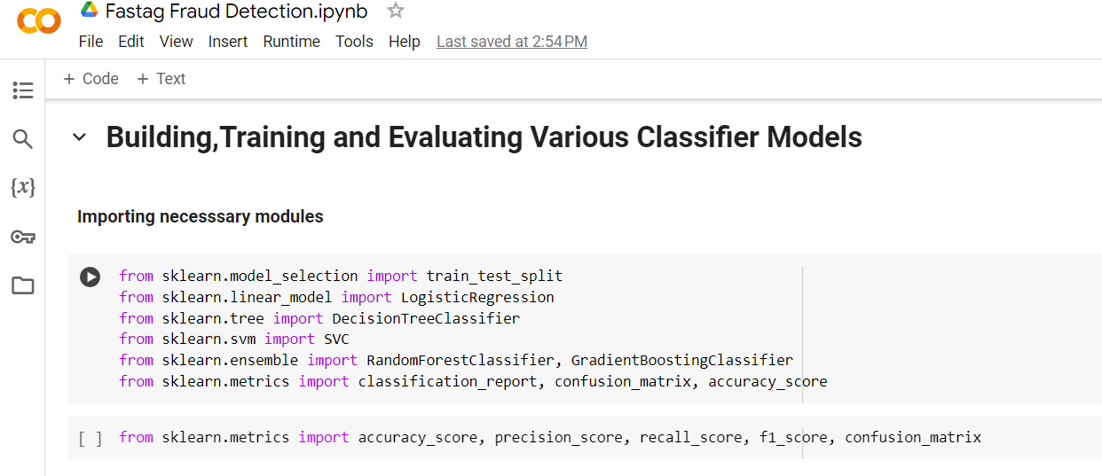
Importing necessary modules to build and evaluate the models
Models :
1) LogisticRegression
2) DecisionTreeClassifier
3) SVC
4) RandomForestClassifier
5) GradientBoostingClassifier
Evaluation Metrics :
Accuracy
Precision
Recall
F1 Score

Slide 11
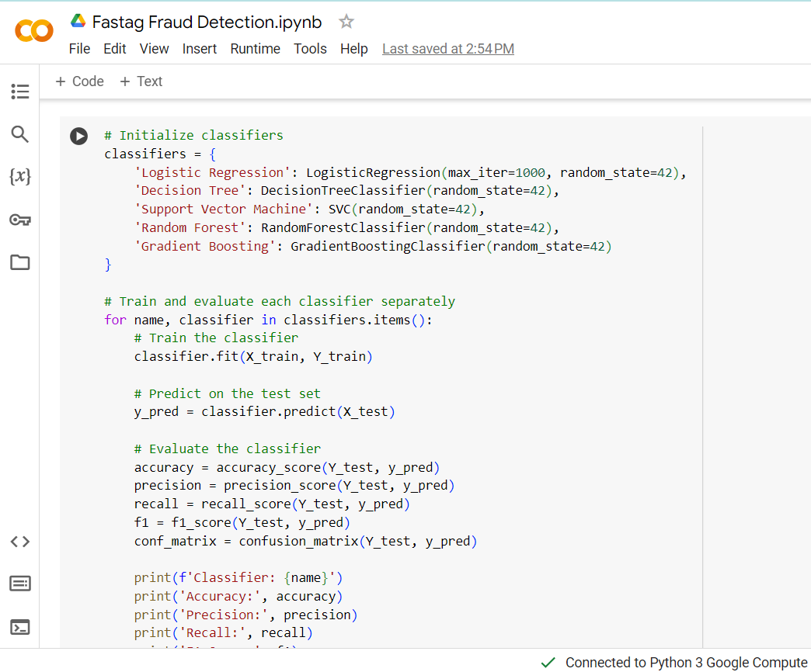

Building ,Training and evaluating the models : LogisticRegression ,DecisionTreeClassifier, SVC,
RandomForestClassifier,GradientBoostingClassifier

Slide 12
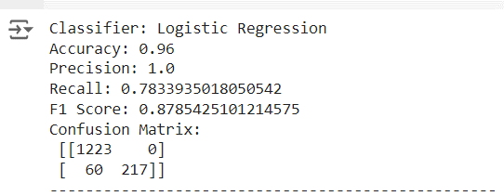
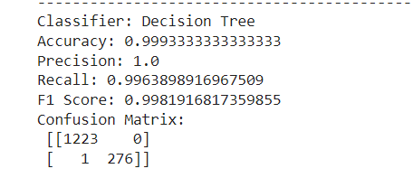
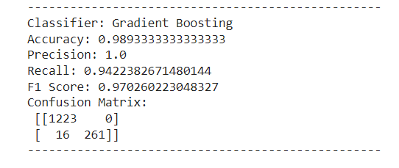
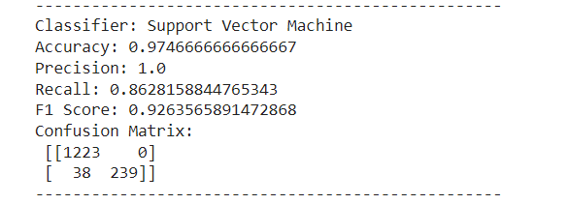
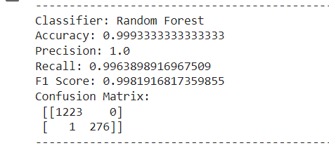
Values of Evaluation Metrics for each model :

Slide 13
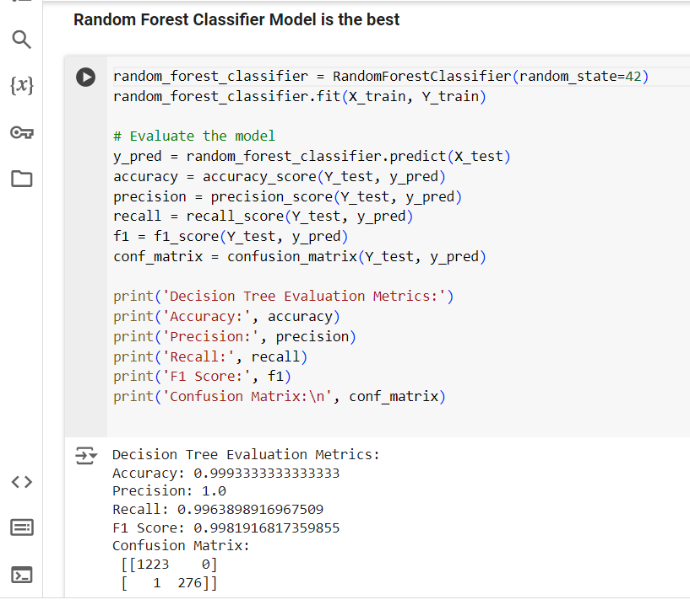
After evaluation Random Forest Classifier Model is found to be the best

Slide 14
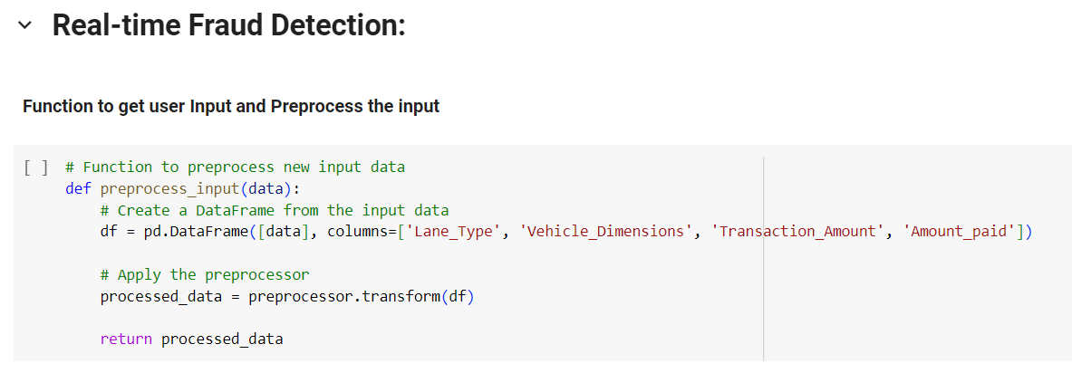
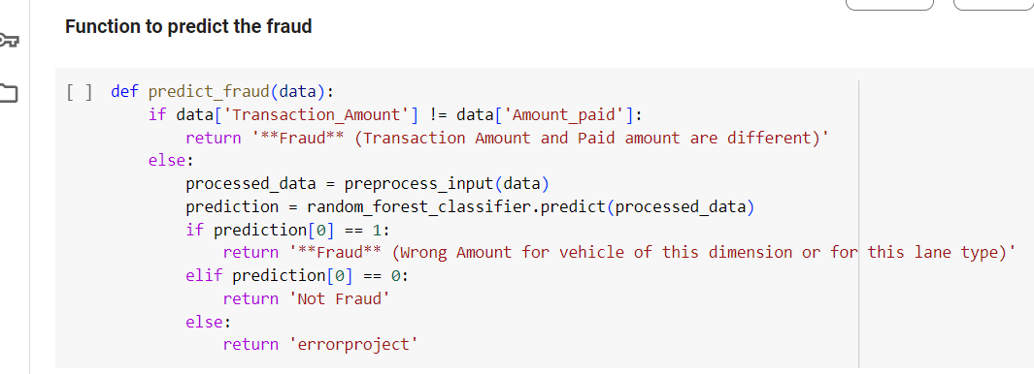
User Input and Prediction
Preprocess_input Function: Gathers user input (‘Lane_type’,’Vehicle_Dimension’,’Transaction_Amount’,’Amount_paid’ )
Preprocesses the input data
predict_fraud function: Function to predict the fraud transaction

Slide 15
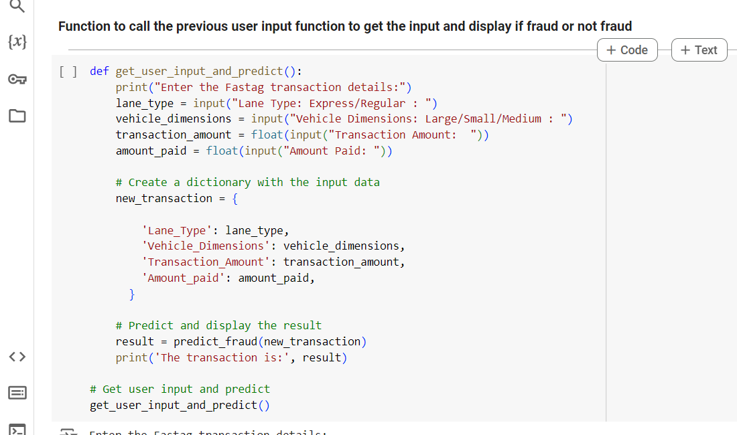
get_user_input_and_predict() function :Function to call the previous user input function to get the input
and display if fraud or not fraud as output

Slide 16
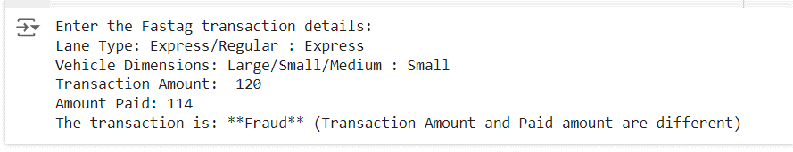
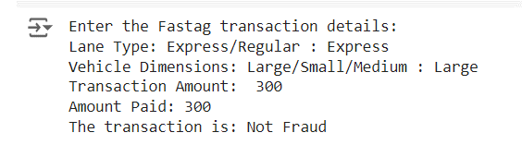
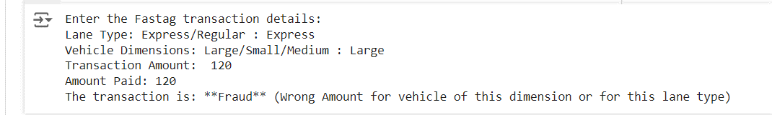
Fraud Detection Output :

